Slide 1

Chapter 2
Euclidean Vector Spaces
Notes:
prepared by Razana Alwee

Slide 2
Vector
We defined a vector, with n entries, as n×1 matrix
Vectors are used not only in mathematics, but in virtually every branch of science
In this chapter, we study sets of vectors and analyze their additive properties.
The concepts presented here, in the context of vectors, are fundamental to the study of linear algebra.

Slide 3
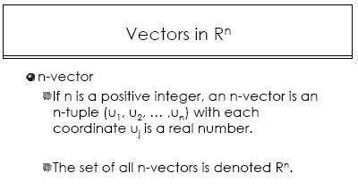

Slide 4
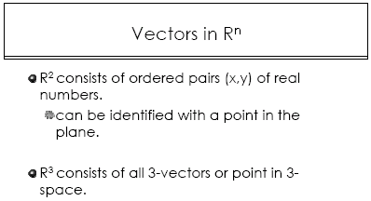
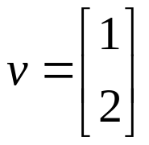
A row vector v = (1,2)
A column vector

Slide 5
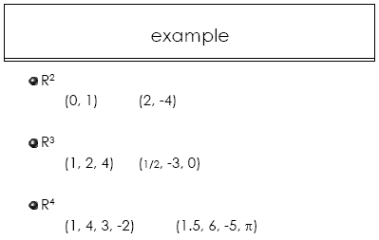
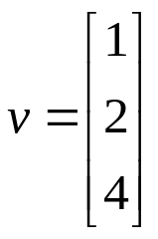
R³
V=(1,2,4)

Slide 6
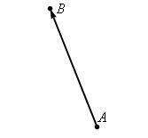
Cont…
Vectors are typically denoted with a boldface lower case letter. For instance we could represent the vector by b
Also when we’ve explicitly given the initial and terminal points we will often represent the vector as, ;

Slide 7
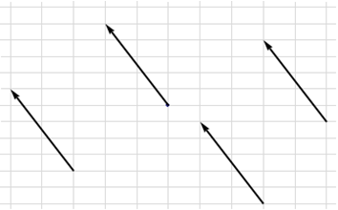
Cont…
Two vectors with the same magnitude but different directions are different vectors and likewise two vectors with the same direction but different magnitude are different.
Vectors with the same direction and same magnitude are called equivalent and even though they may have different initial and terminal points we think of them as equal and so if v and u are two equivalent vectors we will write
Equivalence vectors

Slide 8

Vector in R^{n}
Geometrically, in R² and R³ a vector is directed line segment from the origin to the point whose coordinates are equal to the components of the vector
Example
  Directed line segment from the origin(0,0) to the point(1,2)
(1,2)

Slide 9
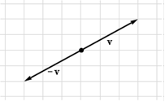
Basic Arithmetic in Vector
The first is the zero vector. The zero vector, denoted by 0, is a vector with no length.
If v is a vector then the negative of the vector, denoted by –v, is defined to be the vector with the same length as v but has the opposite direction .
negative of a vector

Slide 10
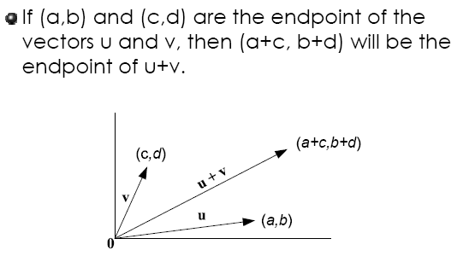
Cont…

Slide 11
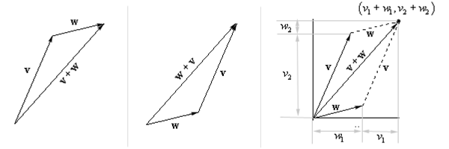
Let v = (v₁,v₂) and w =(w₁, w₂) .Then the sum of v + w can be demonstrated as the figures above.

Slide 12
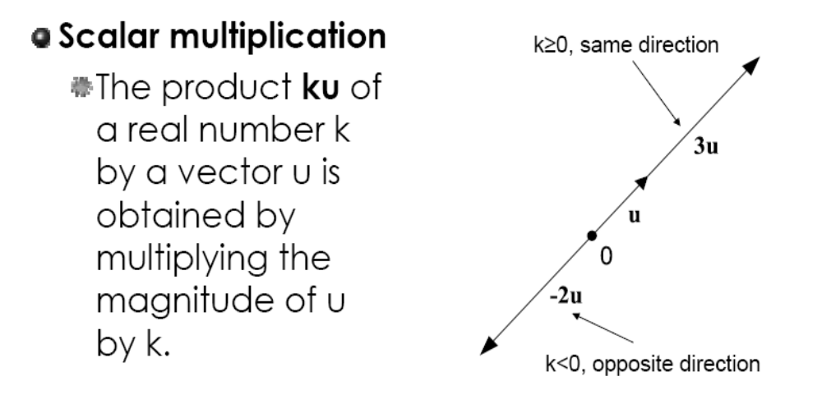
Cont…

Slide 13
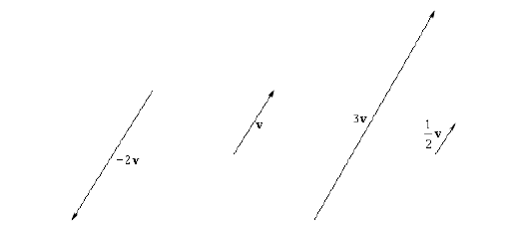
Scalar Multiples

Slide 14
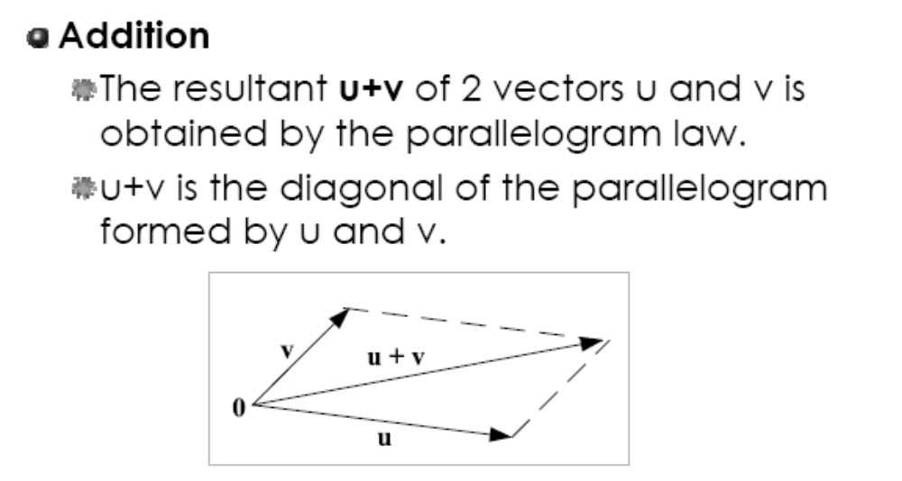
Vector

Slide 15
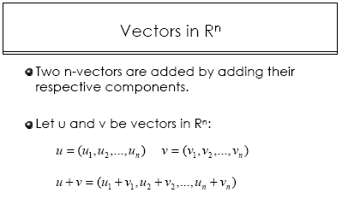

Slide 16
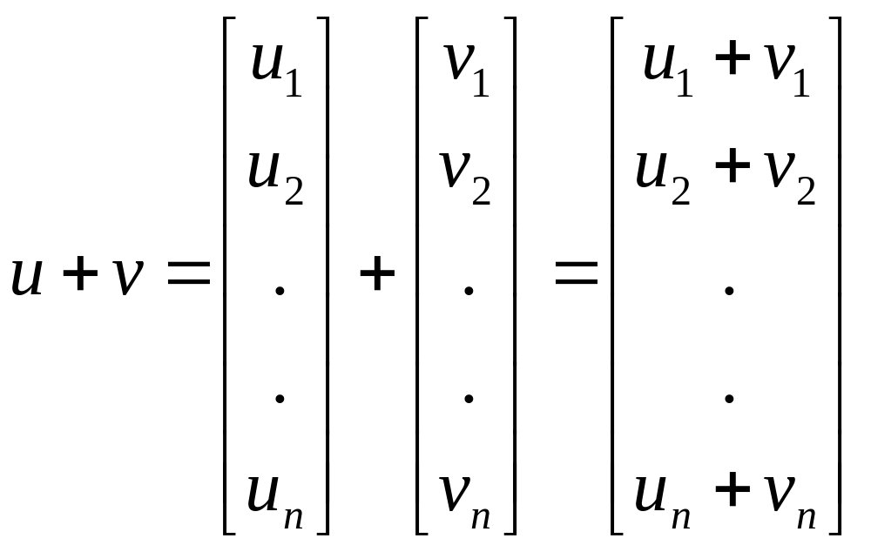
Addition of Column vectors

Slide 17
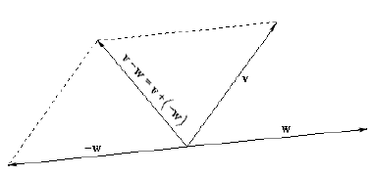
Cont…
Suppose that we have two vectors v and w then the difference of w from v, denoted by v-w is defined to be,

Slide 18
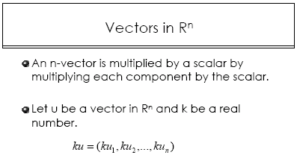
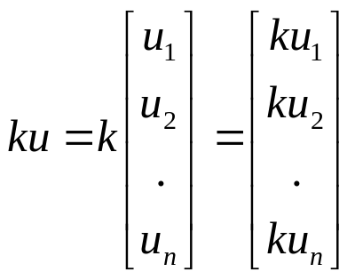

Slide 19
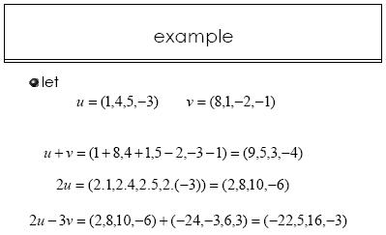

Slide 20
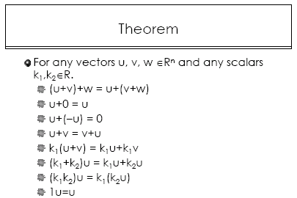

Slide 21


Norm and Distance of Vector
If v is a vector then the magnitude of the vector is called the norm of the vector and denoted by ||v||. Furthermore, if v is a vector in R² then,
and if v is in R³ then we write it as

Slide 22
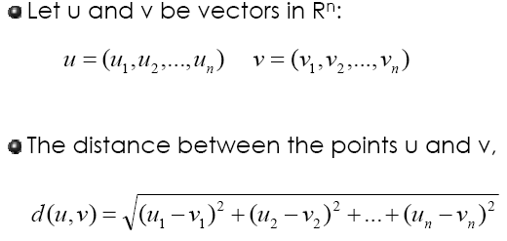
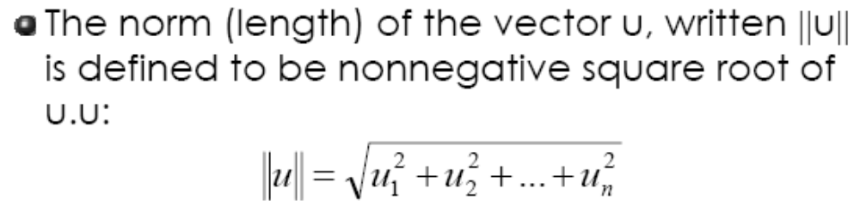
Cont…

Slide 23
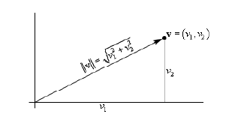
Norm of the vector

Slide 24
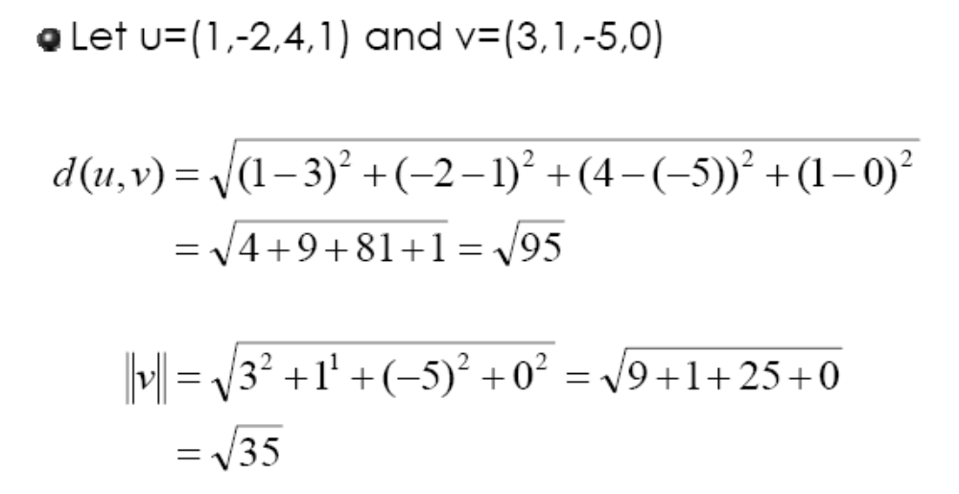
Example

Slide 25
Distance of The Vector
Let say and . The distance between u and v, in R^{n} is known as Euclidean Distance and can be computed using the following formula:

Slide 26
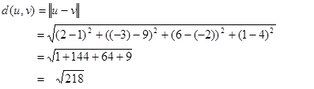

example
Suppose u = (2, -3, 6, 1) and v = (1,9, -2, 4). Find the Euclidean distance between u and v in R⁴
^{Solution}

Slide 27
Dot Product and Cross Product
Dot products and cross product are special products of vectors. The dot product is sometimes called the scalar product or the Euclidean inner product.
If u and v are two vectors in 2-space R², or 3 space R³, and θ is the angle between them, then the dot product, denoted by u●v is defined as,

Slide 28
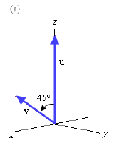

Example
Find the dot product for the following pairs of vectors; (a) u =(0, 0, 3) and v = (2, 0, 2) and θ = 45°

Slide 29
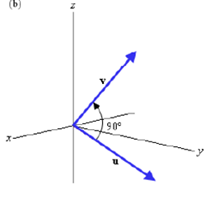

Cont…
(b) u =(0, 2, -1) and v = (-1, 1, 2) and θ = 90°

Slide 30
Theorem
Suppose that and are two vectors in 3-space then,
Similarly, if and are two vectors in 2-space then

Slide 31
exercise
Given u = ( 5, -2) , v = ( 0, 7) and w = ( 4, 10) compute the following:
(a) u●u and ǁuǁ²
(b) u●w
(c) (-2u)●v and u●(-2v)

Slide 32


Cross-Product
Cross product of two vectors is different with the dot products because the first one produces new vectors while the second one gives a scalar.
If u and v are two vectors in 3-space then the cross product, denoted by u×v is defined in one of three ways.
(a) Vector Notation
.
(b) using 2 x 2 determinants
.(c) using 3 x3 determinants

Slide 33


example
Compute u x v for u = ( 4, -9, 1) and v = ( 3, -2, 7).
Solution: This problem can be solved using either one of the three definitions above. In this case, we will use the third one.

Slide 34
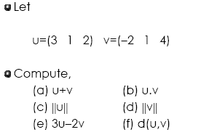
Exercise
-5u

Slide 35

Linear Combination
Given a set of vectors in , which have a same length of m, a linear combination of these vectors is defined as the vector
= , where
are scalars.

Slide 36


Example
Consider a set of vectors
Can we express the following vectors
as a linear combinations of v₁ and v₂ ?

Slide 37



solution
For the first vector u to be a linear combination of v₁ and v₂ we must have
which is a linear system. The augmented matrix is
Thus,

Slide 38


Cont…
For the second vector w to be a linear combination of v₁ and v₂ , we must have
which is a linear system. The augmented matrix is
Thus w cannot be expressed as a linear combination of v₁ and v₂ .

Slide 39





example
Show that the matrix is a linear combination of the matrices
and
Solution:
Firstly we must find the values of c₁,c₂ and c₃ such that
That is

Slide 40
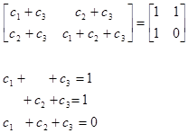
Cont…
Perform the scalar multiplication and addition, we get
Solve these equations, we obtain c₁ = c₂ = -1 and c₃ = 2. Thus, matrix A is a linear combination of matrices M₁, M₂ and M₃ .

Slide 41
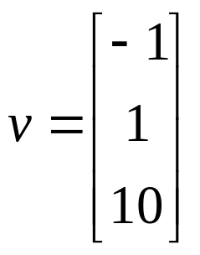
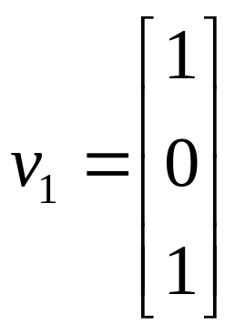
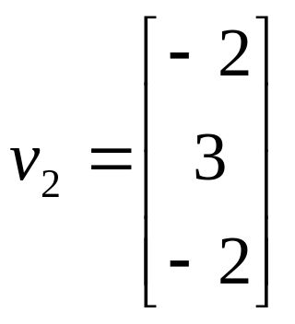
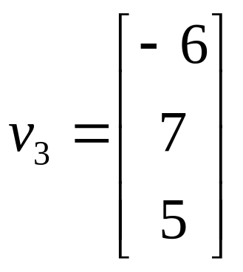
Exercise
Determine whether the vector
is a linear combination of the vectors
and

Slide 42
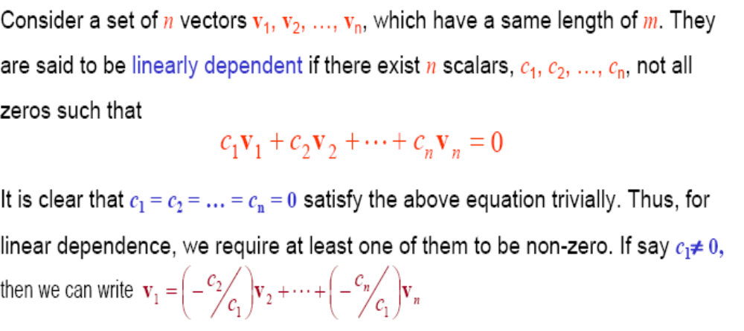
Linear Dependence and Linear Independence

Slide 43
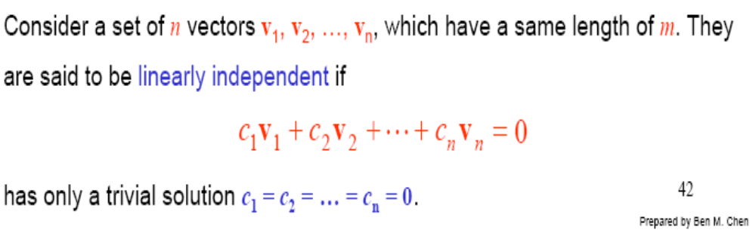
Cont…

Slide 44
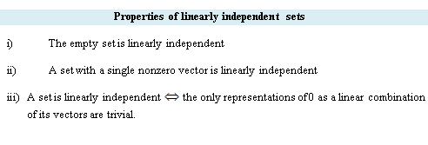
Cont…

Slide 45
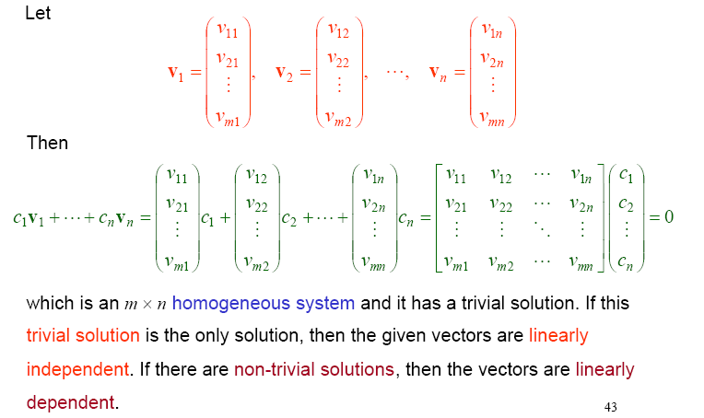

Slide 46
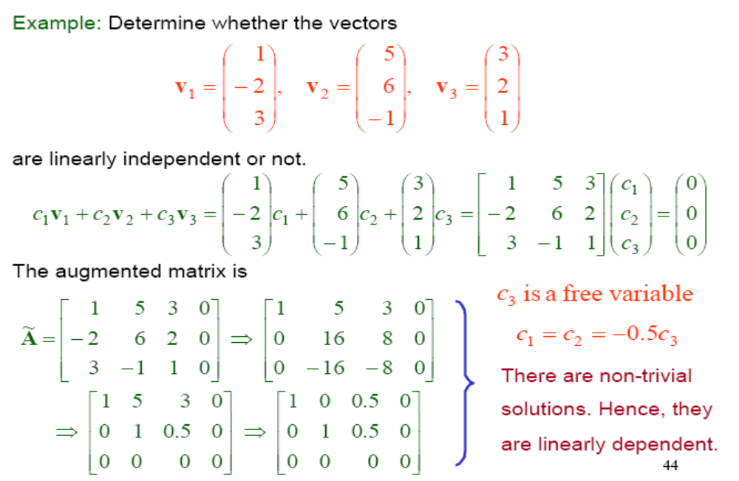
Example 1

Slide 47
Example 2
Vectors i=(1,0,0), j=(0,1,0), k=(0,0,1) in R³
c₁i + c₂j + c₃k = 0
c₁ =(1,0,0) + c₂ (0,1,0) + c₃ =(0,0,1)
This implies that c₁ =0, c₂ =0 and c₃ = 0
Thus set S= {i, j, k} is linearly independent

Slide 48
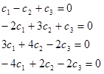
Example 3
Given v₁ = (1, -2, 3, -4), v₂ = (-1, 3, 4, 2), and v₃= (1, 1, -2, -2), Determine whether the above vectors are linearly independent or not.
Solution:
c₁(1, -2, 3, -4) + c₂(-1, 3, 4, 2) + c₃(1, 1, -2, -2) = 0
The system equation is;

Slide 49

Cont…
Change into matrix representation, we obtain
Solving these linear equations, we found that c₁ =0, c₂ =0 and c₃ = 0. This indicates that the system has only the trivial solution and we can say that these three vectors are linearly independent.

Slide 50
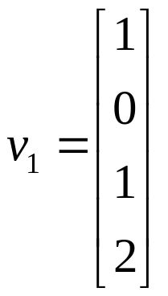
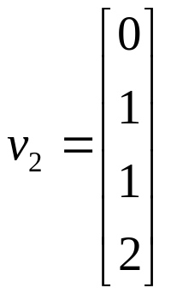
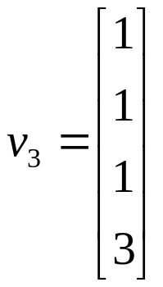
Exercise 1
Determine whether the vectors
are linearly independent or linearly dependent.
and

Slide 51
Exercise 2
Determine whether the vectors
v₁=(1,0,0) , v₂=(0,1,0) , v₃=(0,0,1)
form a linearly dependent set or linearly independent set.

